Slide 1
Attribute Grammar and Intermediate Code Generation
Sabrina Tarin Chowdhury

Slide 2
Attribute Grammars
Parsing, semantic analysis, and intermediate code generation are typically interleaved
An attribute grammar links syntax with semantics
Every grammar production has a semantic rule with actions (e.g. assignments) to modify values of attributes of nonterminal
A terminal and nonterminal may have a number of attributes

Slide 3
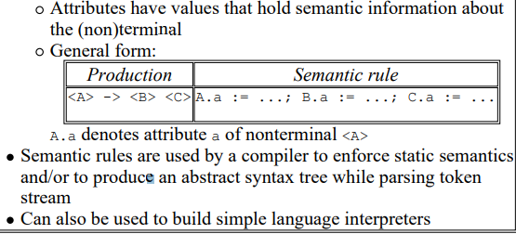
Attributes

Slide 4
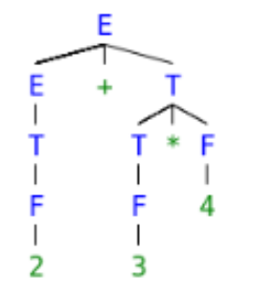

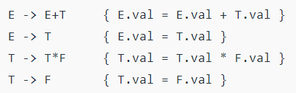
Example
Let’s take a string to see how semantic analysis happens S = 2+3*4.
Syntax Grammar
Syntax Grammar
Semantic Rule
The val attribute of a non-terminal holds the total value of subexpression described by the terminal
we will move bottom-up in the left to right fashion for computing the translation rules of our example.

Slide 5
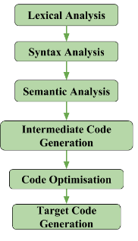
Intermediate Code Generation
Using parser tree and attribute grammar the intermediate code is generated.
Front end of a compiler translates a source program into an independent intermediate code, then the back end of the compiler uses this intermediate code to generate the target code.
Machine-independent intermediate code
If we generate machine code directly from source code then for ’n’ number of target machine we will have ’n’ number of optimizers and ’n’ number of code generator but if we will have a machine-independent intermediate code, we will have only one optimizer.

Slide 6
3 Ways of Intermediate Code Representation
Postfix Notation: Also known as reverse Polish notation or suffix notation. The ordinary (infix) way of writing the sum of a and b is with an operator in the middle: a + b The postfix notation for the same expression places the operator at the right end as ab +.
Three-Address Code: A statement involving no more than three references(two for operands and one for result) is known as a three address statement. A sequence of three address statements is known as a three address code. Three address statement is of form x = y op z, where x, y, and z will have address (memory location). Sometimes a statement might contain less than three references but it is still called a three address statement.

Slide 7
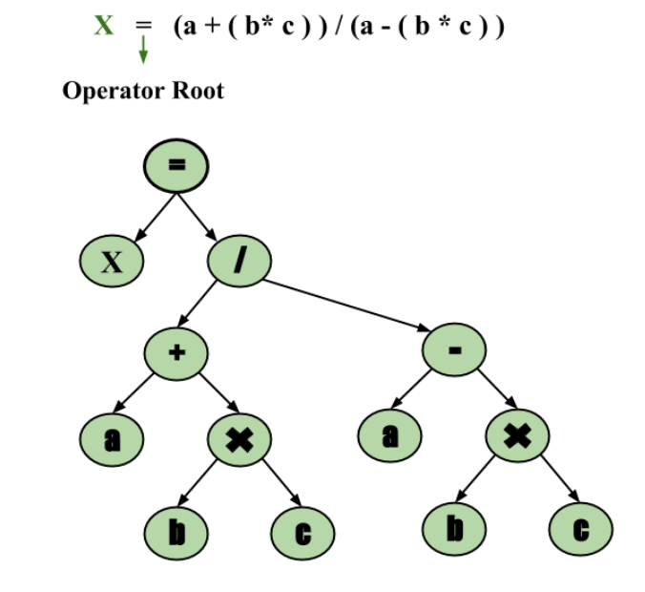
3 Ways of Intermediate Code Representation
Syntax Trees − It is condensed form of parse tree in which leaves are identifiers and interior node will be operators.

Slide 8
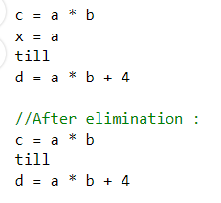
Code Optimization
The code optimization in the synthesis phase is a program transformation technique, which tries to improve the intermediate code by making it consume fewer resources (i.e. CPU, Memory) so that faster-running machine code will result.
Code Optimization is done in the following different ways:
Dead Code Elimination:

Slide 9
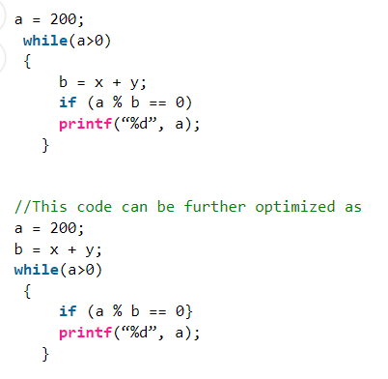
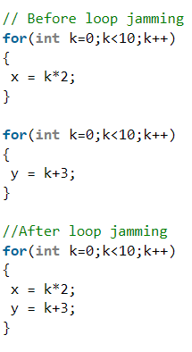
Code Optimization
Loop Optimization Techniques:
Loop Jamming:
Two or more loops are combined in a single loop. It helps in reducing the compile time
Loop invariant statements are brought out of the loop.
a=a-1;
}
a=a-1;
}

Slide 10
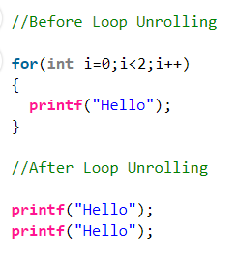
Code Optimization
Loop Unrolling:
It helps in optimizing the execution time of the program by reducing the iterations.
It increases the program’s speed by eliminating the loop control and test instructions.

Slide 11
Code Optimization
Function Inlining:
Here, a function call is replaced by the body of the function itself.
This saves a lot of time in copying all the parameters, storing the return address, etc.
Function Cloning:
Here, specialized codes for a function are created for different calling parameters.
Example: Function Overloading

Slide 12
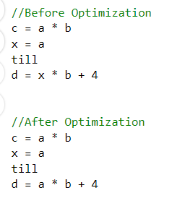

Code Optimization
Compile Time Evaluation:

Slide 13
Replace with Faster Operator
Example 1 :
Multiplication with powers of 2 can be replaced by shift left operator which is less
expensive than multiplication
a=a*16
// Can be modified as :
a = a<<4

Slide 14
Linux commands
cd (change directory)
ls (list directory)
pwd (print working directory)
cat (lists contents of a file)
mkdir (make directory)
rmdir (remove directory)
rm file (remove file)
tab completion
man cmd (manual pages)
vim/emacs/pico

Slide 15
More Linux Commands
Ctrl-z (suspends a process – moves it to the background)
Fg (foreground – resumes a suspended process)
ps (shows all of the processes you have running)
cd ~ (takes you back to your home directory)
cp source destination (copy source to destination)
mv oldname newname (renames a file)

